Slide 1
ALC Marketing & Program Evaluation Survey Project
Elma Garcia, Hanna Grossman, Citlally Reynoso, and Faith Tsang

Slide 2
The Problem
Goal: identify ways to see where the UCLA Extension American Language Center (UNEX-ALC) stands in term of enrollment and overall success
A survey of mostly open ended questions has been given to some students at UCLA Extension ALC
There are two main goals of this project:
Create the best possible survey for future years, allowing for more effective program evaluation
Suggest marketing techniques that will allow UCLA Extension to improve the program and attract more students
Notes:
Tally

Slide 3
Explanation of Variables
We had nine columns of answers from the survey.
Q1: How did you learn about the UCLA Extension American Language Center program?
Q2: Why did you choose to study at the UCLA Extension American Language Center?
Q3: What do you like best about your American Language Center program?*
Q4: What would improve your experience at ALC?*
Q5: What was your experience learning or studying foreign languages before you came to the American Language Center?
Q6: Please describe your work experience before you came to the American Language Center.
Q7: What are your most important goals after you complete your studies at the American Language Center?
Q8: Would you recommend the ALC program to a friend? (numeric)
Q8_text: Would you recommend the ALC program to a friend? (text)
Notes:
Elma

Slide 4
The Dataset
Note: data was collected from multiple surveys
Ex - question 3:
“What did you like best about your professor?”
“What did you like best about this class?”
“What do you like best about your American Language Center Program?”
Our data set had 175 rows and 9 columns.
About ninety rows of data only contained answers for Question 3, Question 4, and Question 8 as they came from the separate survey, meaning that the other columns had NA values.
Notes:
Elma

Slide 5
Data Cleaning
Removed special characters, punctuation, whitespaces, and all basic stopwords in the English language, and turned all letters to lowercase
Created extra stop words after looking at the resulting word frequencies
Extra stop words included words such as "null", "can", "also", and "just"
Notes:
Faith

Slide 6
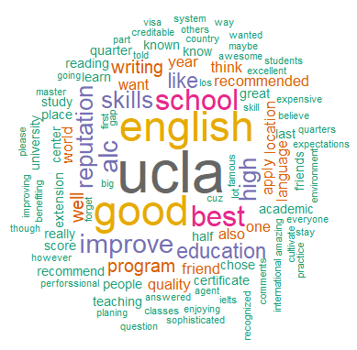
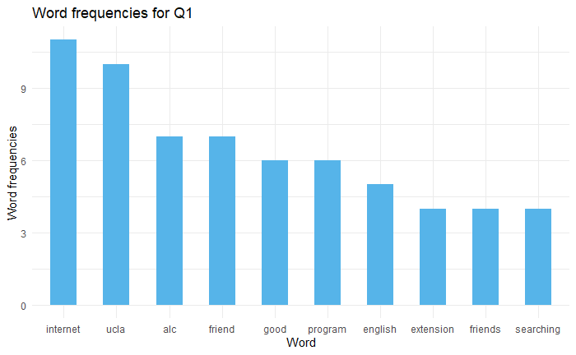
Exploratory Data Analysis
In word frequency barplots, we showed the top ten words that appeared most frequently for each open-ended question.
Word clouds produce an interesting visualization of how often words appeared.
Notes:
Faith

Slide 7
Sentiment Analysis
What is it?
Sentiment analysis is a form of text analysis that extracts words with positive or negative sentiment associations
Subjective expressions such as opinions, beliefs, and views are kept and objective information is rejected
Why it is important?
Optimize marketing strategies by understanding how students feel about ALC and what changes they want to see in the future
Notes:
Tally

Slide 8
Semantic Networks
Semantic networks resemble neural networks and consist of nodes and edges
Each node represents a word
Each edge has a weight that shows how often the two connected words appear together
Goal: understand the context that words appear in to better understand the survey responses
Notes:
Hanna

Slide 9
Results and Recommendations

Slide 10
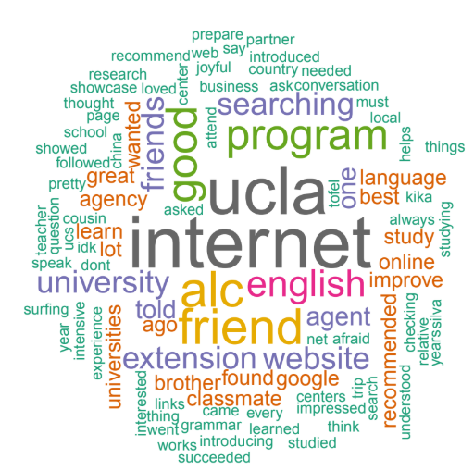
Q1: How did you learn about the UCLA Extension American Language Center program?
Top answer choices:
Family member
Friends
Internet
Agent
Previously visited UCLA
We recommend multiple choice:
Few answers repeated many times amongst students
Minimize response fatigue, increasing response rate on the survey as a whole
Notes:
Faith

Slide 11
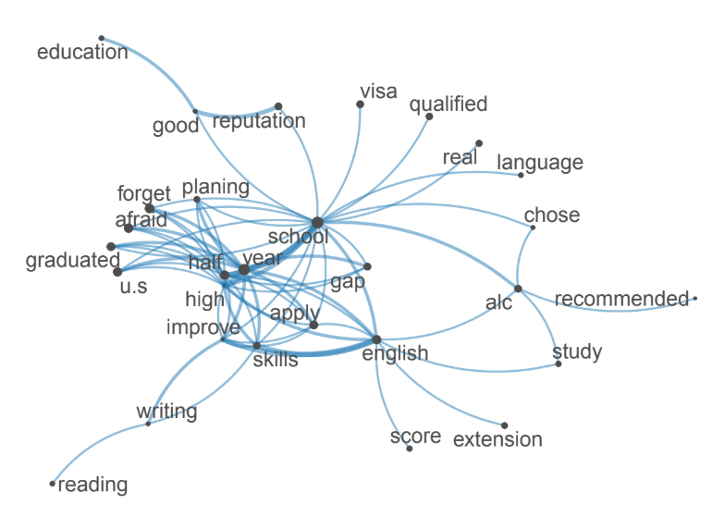
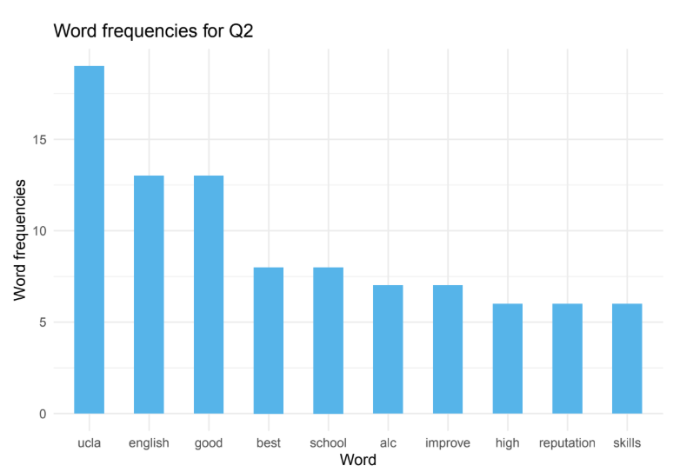
Q2: Why did you choose to study at the UCLA Extension American Language Center?
Top answer choices are:
• To learn English (improve reading/writing skills)
• To improve resume/CV
• Desire to attend UCLA or another top university in the future
We recommend open ended or select all that apply based on the goal of the question
Notes:
Hanna

Slide 12
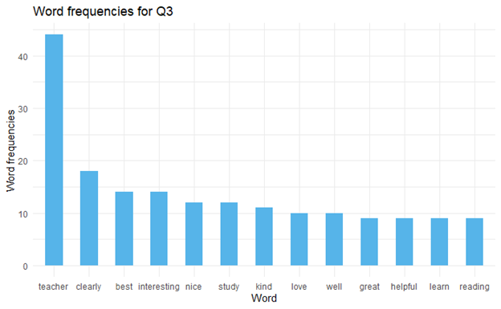
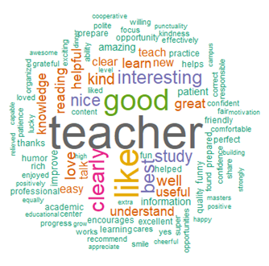
Q3: What do you like best about your American Language Center program?
Positive Sentiment Analysis
Maintain open ended format
Notes:
Tally

Slide 13
Q3: What do you like best about your American Language Center program?
Environment:
Teachers who are nice, kind, and helpful nurture the kind of environment that students want to be a part of
Curriculum:
Clarity of the information, what they learned, and the practice they received from the program
Recognize and value
Prestige:
CVs or resumes comes with a level of prestige that can positively impact their careers
Notes:
Tally

Slide 14
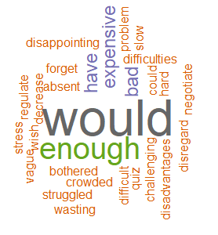
Q4: What would improve your experience at ALC?
Overview
Negative and positive sentiment analysis in conjunction with neural networks
Maintain open ended question structure
Negative Sentiment Analysis
Corrections
Very little negative feelings expressed
Notes:
Tally

Slide 15
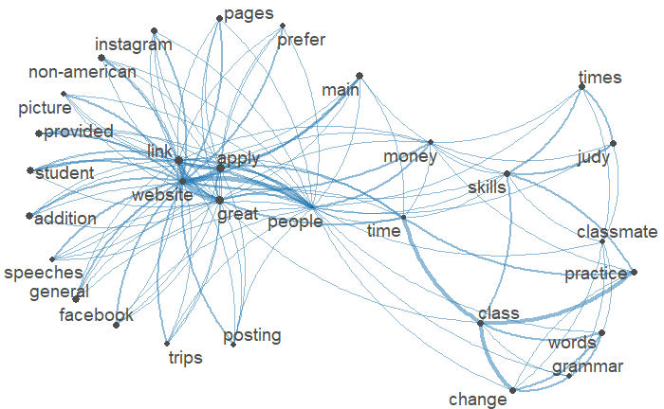
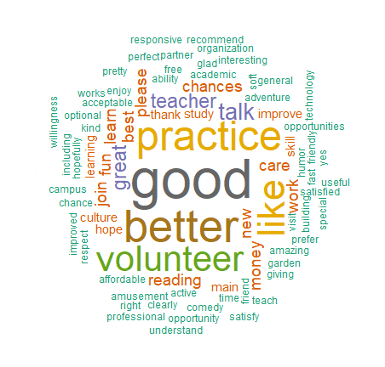
Q4: What would improve your experience at ALC?
Word Cloud
Volunteer opportunities
More Practice
Humor in the classroom
Neural Network
Social media can communicate campus culture
Connection
Expensive, money, affordable
Notes:
Tally

Slide 16
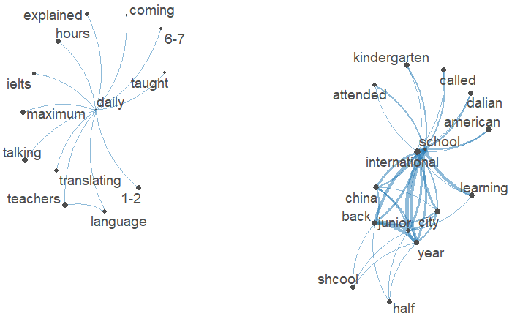
Q5: What was your experience learning or studying foreign languages before you came to the American Language Center?
We recommend select all that apply:
Confusion surrounding the question
Reword question to “What was your experience learning or studying English before you came to the American Language Center?”
Notes:
Hanna

Slide 17
Q5: What was your experience learning or studying foreign languages before you came to the American Language Center?
We recommend making the answer choice options:
I was exposed to English in school
I was exposed to English in my work
I was exposed to English through social media and/or television
I have never been exposed to English before
Notes:
Hanna

Slide 18
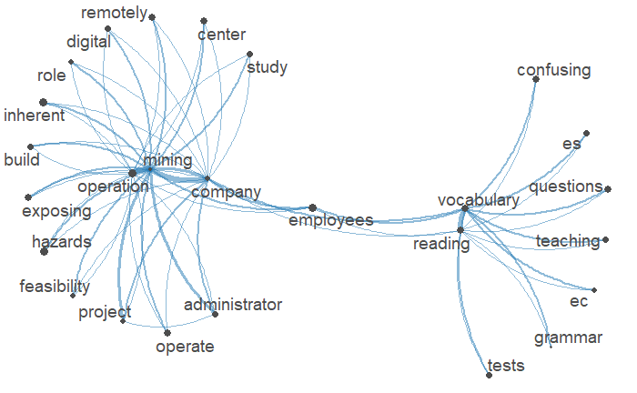
Q6: Please describe your work experience before you came to the American Language Center.
Make question into two parts:
Has the student worked before (yes/no)
If yes, then what was their work experience? (open ended).
Many responses that did not answer the question. Many responses say the student had never worked before. We believe by making this a two part question, it will clarify the question, and will therefore allow for a more successful analysis.
Notes:
Faith

Slide 19
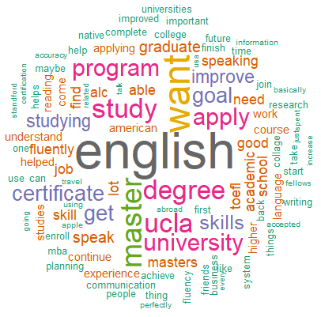
Q7: What are your most important goals after you complete your studies at the American Language Center?
We recommend keeping this open ended:
Yields a wide variety of responses
Useful for analysis
Top responses below:
Bachelor’s degree
Master’s degree
Communicating with clients in English
Certificate from UCLA Extension
Continuing to improve English
Making friends
Notes:
Elma

Slide 20
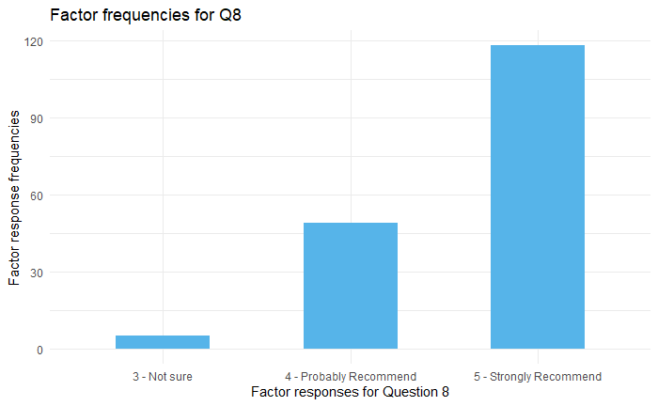
Q8: Would you recommend the ALC program to a friend?
We recommend keeping this multiple choice, but changing the choices to "don't recommend", "not sure", and "recommend".
With 3 options, rather than 5, we believe we would have a larger amount of students in each category, allowing us to analyze the differences between responses for each category more effectively.
Notes:
Elma

Slide 21
Conclusions

Slide 22
Challenges of the Study
At first we had about 10 complete rows of responses
Managed an analysis with this available data, but it was difficult to provide actionable results due to the lack of responses.
Dr. Thomas later provided more data, allowing for a richer analysis.
Data came from a variety of surveys, each with slightly different questions.
Wanted to analyze the data by category in question 8, but there were not enough observations in “not sure” to make a meaningful analysis.
Found that the “probably recommend” and “strongly recommend” categories were too similar to find meaningful differences between the two categories.
Notes:
Hanna

Slide 23
Overall Conclusions and Recommendations
Program Benefits:
The environment teachers created for learning and the curriculum covered by courses
The prestige of UCLA on CVs and resumes
Students Would Like:
Volunteer opportunities
Incorporation of humor in the classroom
Increasing talking opportunities
Incorporate links to social media platforms like Facebook and Instagram
We recommend choosing a combination of question types to avoid response fatigue
An updated survey can be distributed to students at UCLA Extension ALC, allowing for further analysis to gain marketing insights
Notes:
Tally

